Slide 1


AMAZON SALES DATA ANALYSIS
WIREFRAME DOCUMENTATION

Slide 2
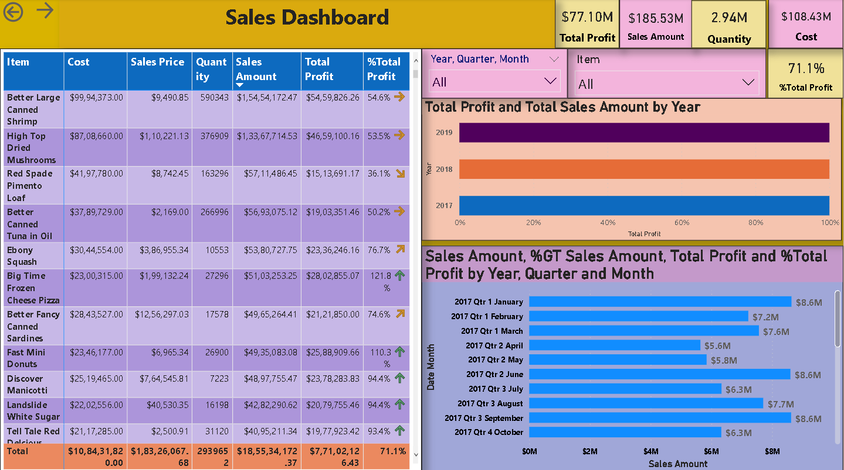
Key Insights:

Slide 3
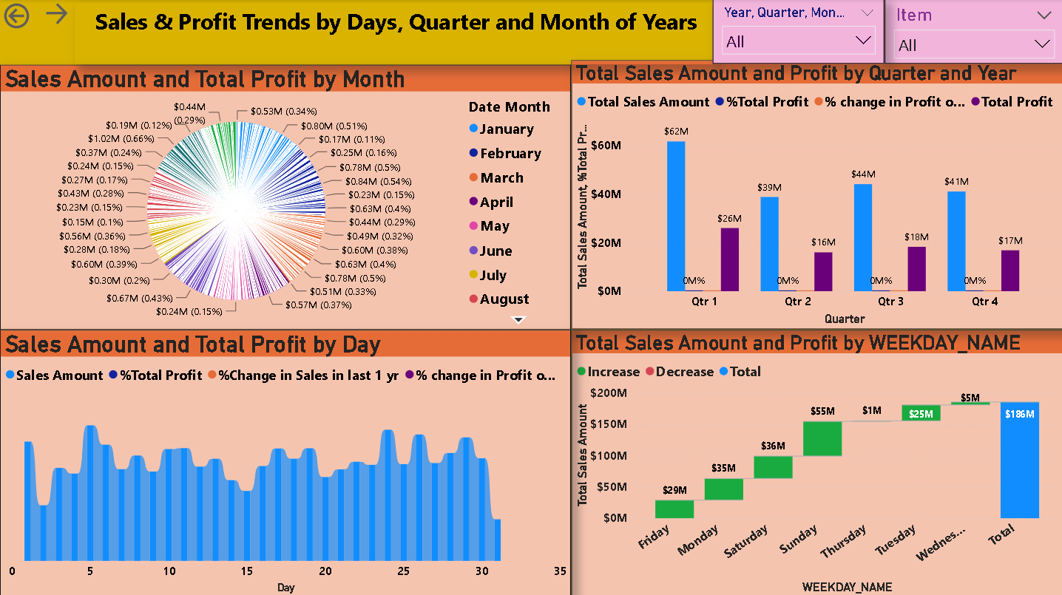
Sales Analysis:

Slide 4
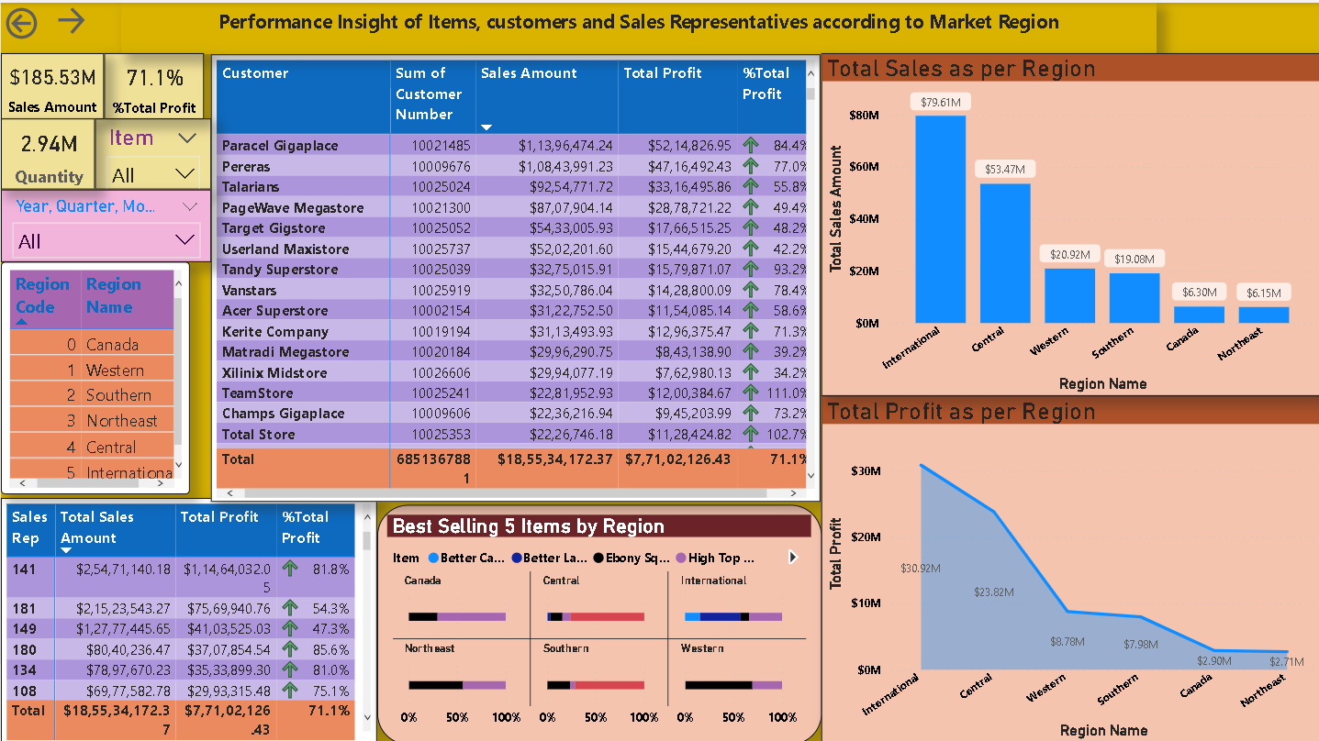
Performance Analysis(Region Wise):

Slide 5
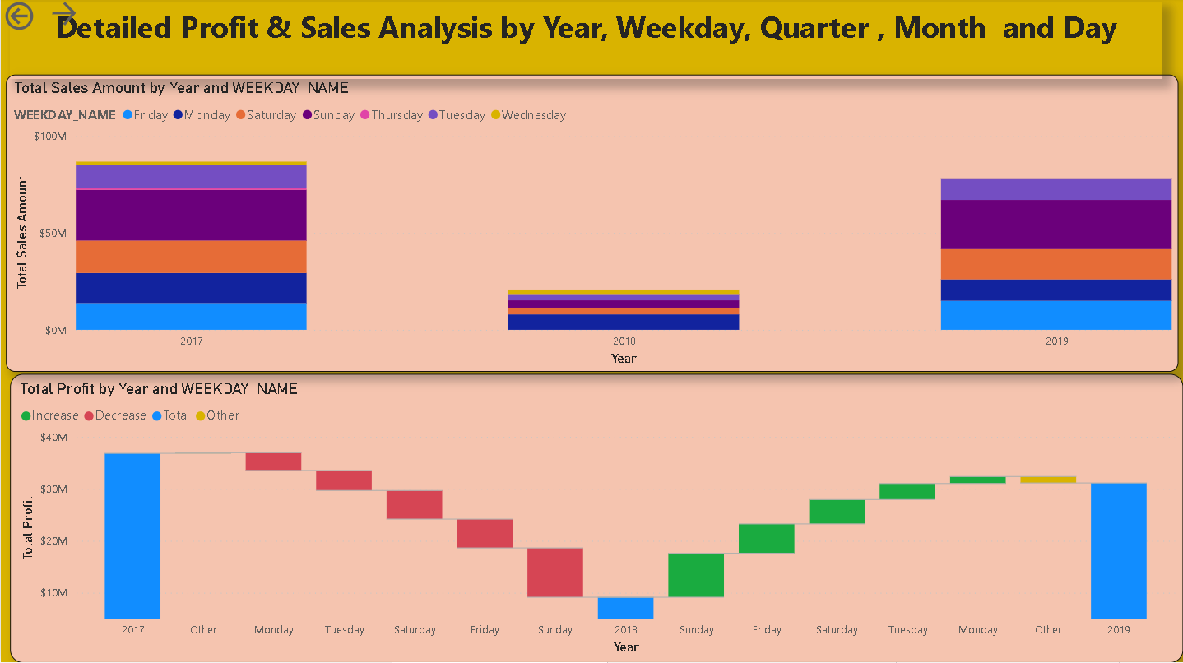
Profits:

Slide 6
Learning Insights:
From this project I have learned the Analyzing the Data using different types of strategies and in different platforms like PowerBI ,Tableau etc.
This project is about the sales data analysis, Here this data is from Amazon sales data. From this analysis I can say that Amazon has raised its profits in the business yr-2019 and eventually it has raised from 2020
We also looked into the monthly analysis , product wise analysis, anula analysis and many more. So ,this can help to improve the profits by analyzing these insights.

Slide 7
Thank You

